Slide 1

Software Engineering CS-411, FALL 2025
Lecture 1: Course Logistics & Introduction to SE by Prof. Mohamad Kassab
Leonidas Kontothanassis kthanasi@bu.edu

Slide 2
Lecture Outlines
Course Logistics
Introduction to Software Engineering
Notes:
Today were going to go over the course logistics and introduce you to SE

Slide 3
Hello!
Getting to Know Me:
Professor Leonidas Kontothanassis
Contact Info:
Email: kthanasi@bu.edu
Location: CDS-906
Office Hours:
Tue/Thu 4:00-5:30pm
To make the most of our time, come prepared with specific questions you'd like to discuss during our meeting.

Slide 4
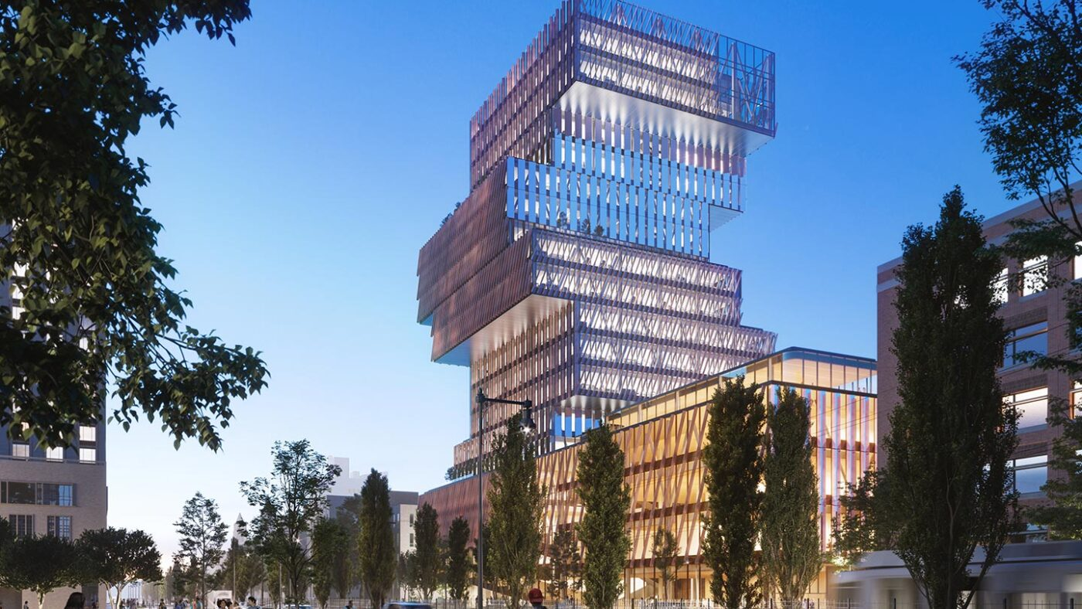
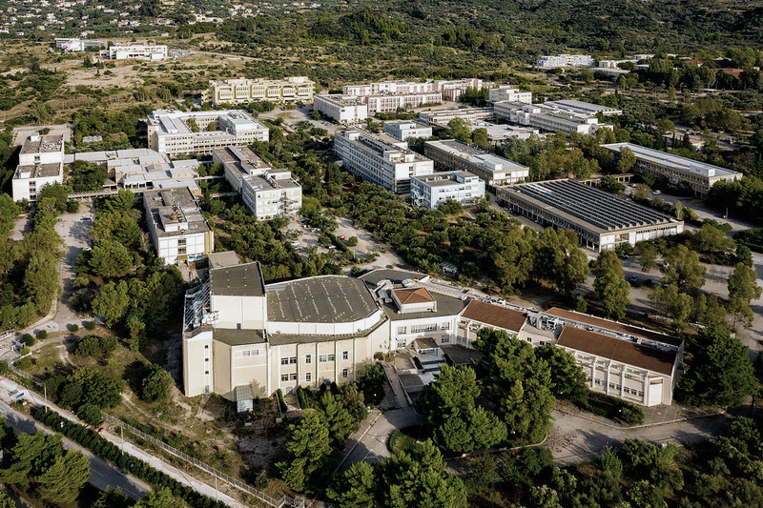
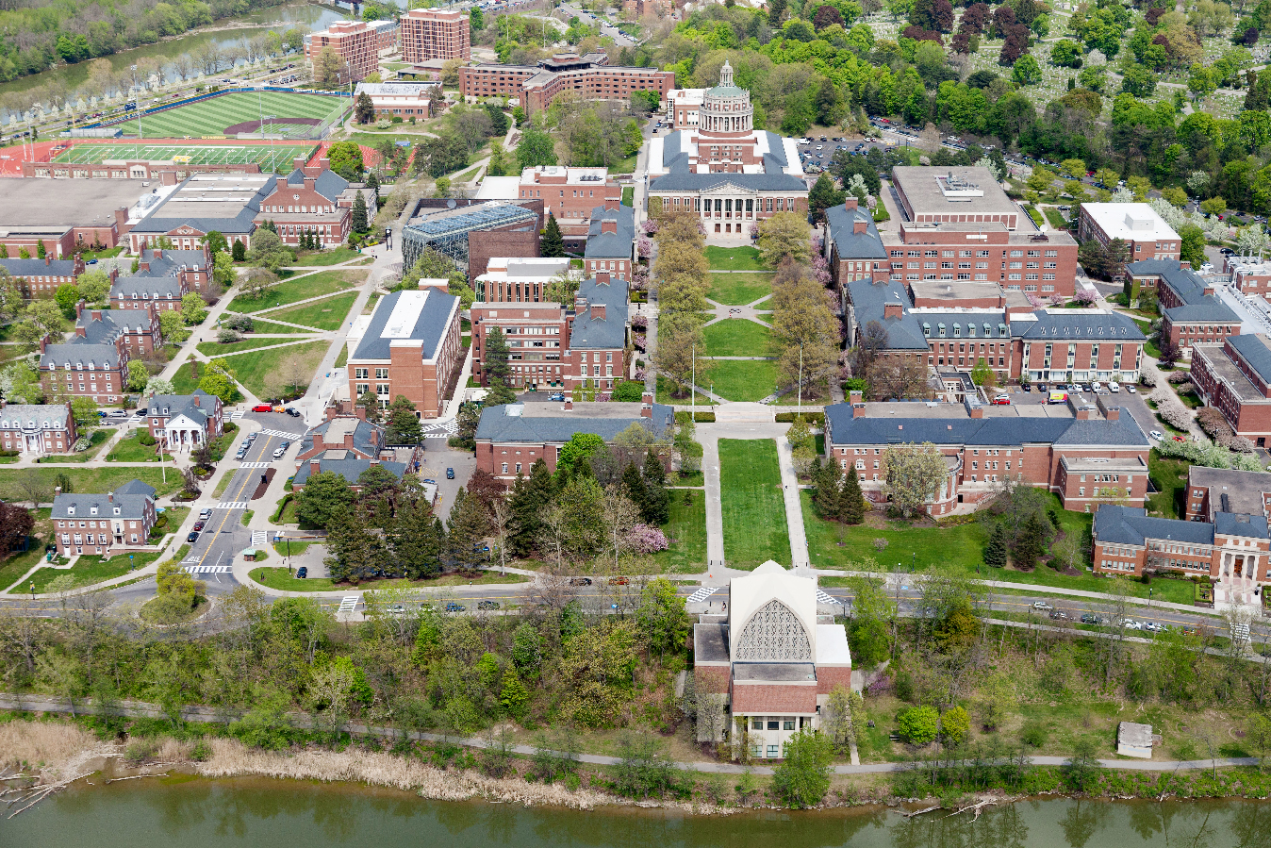
Education
University of Rochester
PhD. in Computer Science, 1996
University of Patras, Greece
Bachelor of Engineering: Computer Engineering, 1990

Slide 5


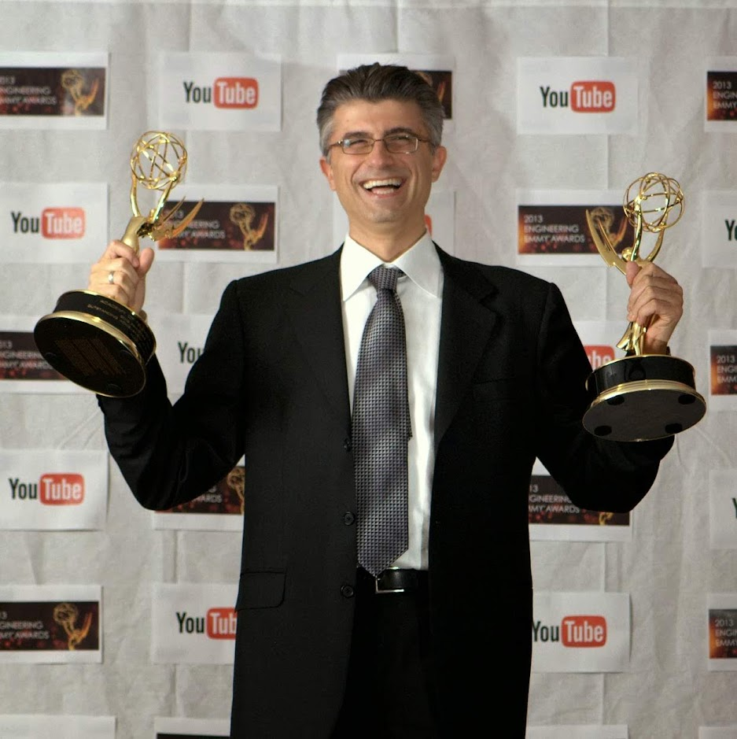





Work Experience
Professor
(2022 – Current)
Senior Director & Distinguished Research Scientist
(2019 – Current)
Senior Director
(2006 – 2018)
Research Scientist
(1999-2003)
Principal Architect
(1999-2003)
Research Scientist
(1996-1999)

Slide 6



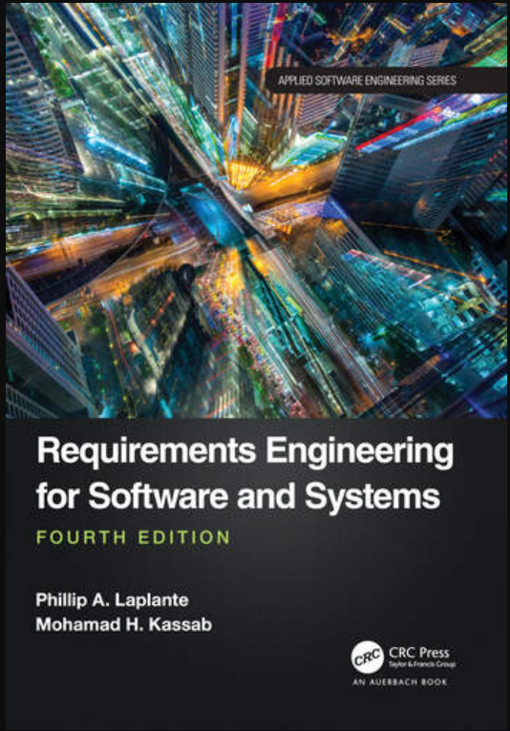


Slide 7
TAs
Maan Qraitem & John Yi
mqraitem@bu.edu & jskyi@bu.edu
Course Assistants
RESPONSIBILITIES
Evaluating your project deliverables
Conducting weekly office hours to assist you with any questions.
Office Hours
TBD in Piazza
CAs
Alvin Zhu, Evan Jaquez, Prisha Sharma, Sara Malik
{alvinz,jaquevan,prishas,smallk}@bu.edu
RESPONSIBILITIES
Evaluating your assignment deliverables
Conducting weekly office hours to assist you with any questions.

Slide 8
You must Subscribe in the course site’s piazza and Gradescope sites
For questions and updates throughout the semester:
Piazza:
https://piazza.com/bu/fall2025/cs411a1a2
Passcode: o1hx8zjoz8m
Gradescope
https://www.gradescope.com/courses/1062496
Passcode: VWZR48
Syllabus:
https://docs.google.com/document/d/15kwjU_-Co4zCQDetKcFkcA2oYDlANi1zlt0kBeZpwN0/edit

Slide 9


What is software engineering?

Slide 10
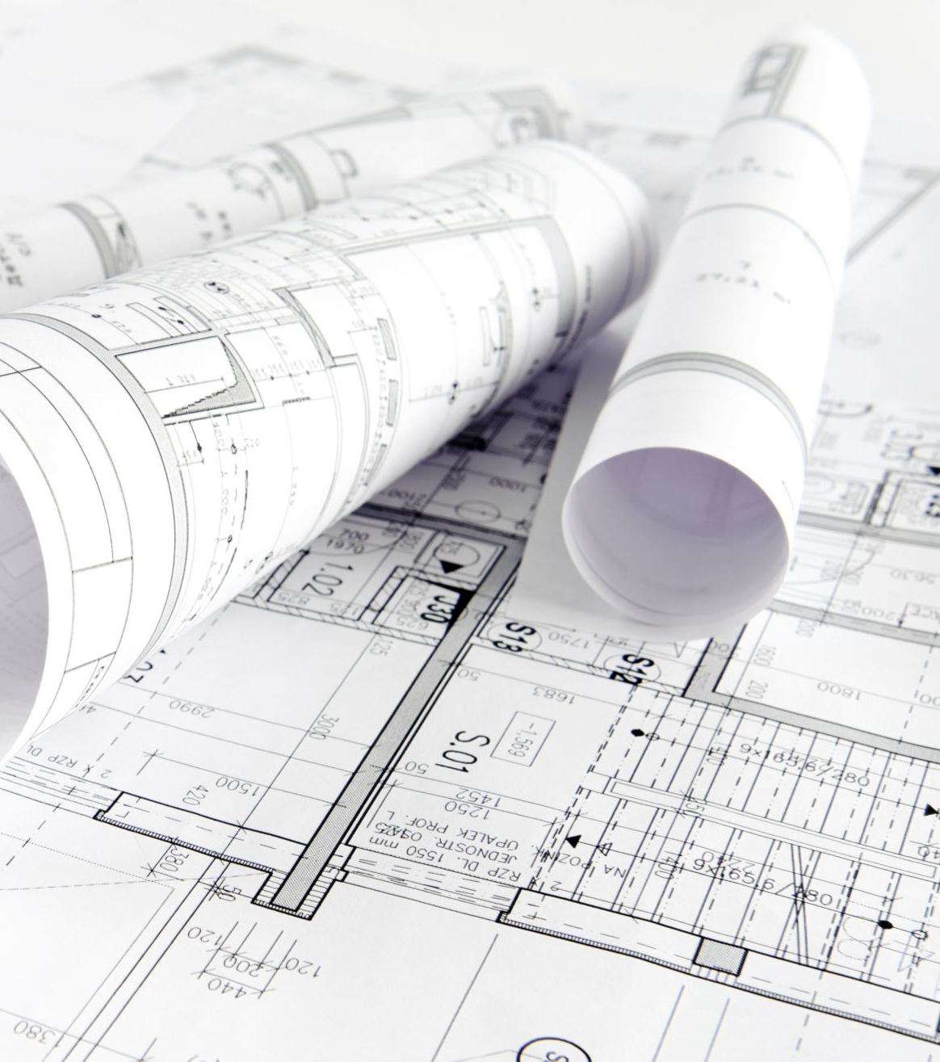
Software as Blueprints
Think of software as the blueprints that architects use to design a building.
Just as blueprints ensure a building's stability, functionality, and aesthetics, software engineering does the same for our digital world.

Slide 11


Real-Life Scenario
Consider a ridesharing app like Uber or Lyft.
Have you ever wondered how these apps match you with a driver, calculate the fare, and guide them to your location?
It's all thanks to software engineering! Every tap on your phone triggers a sequence of events orchestrated by code.

Slide 12
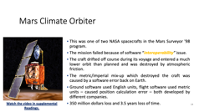
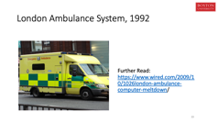
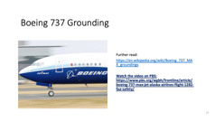
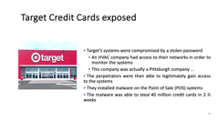
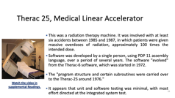
Unmasking Software Catastrophes

Slide 13
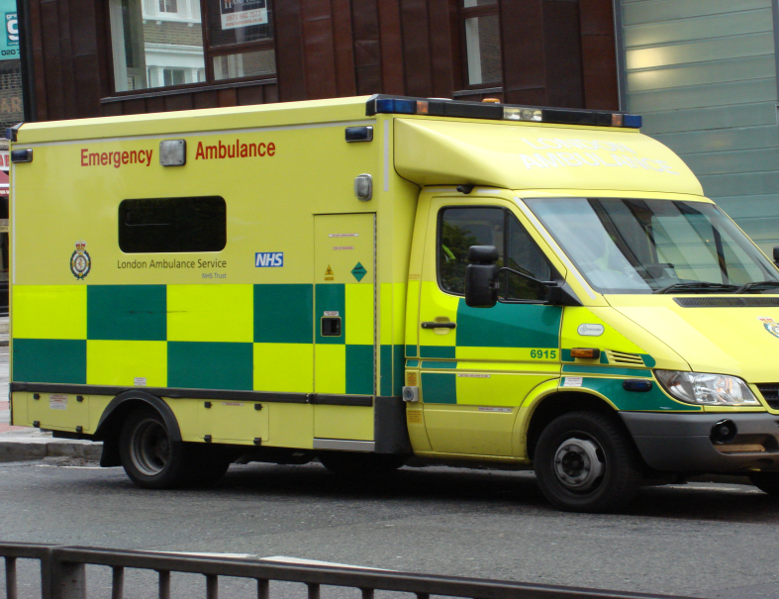
London Ambulance System, 1992
Further Read: https://www.wired.com/2009/10/1026london-ambulance-computer-meltdown/
Notes:
The impact: Estimated 30-50 deaths due to late ambulances.
Load testing was not done. While workflows functioned ok the system lagged badly under load.
Training happened 10 months before operations started. None of the operators remembered much and the system changed between training and delivery dates in subtle ways.
System made wrong choices when given incomplete data (might have been better to tell the operator it could not figure out what to do )
Memory leak in code made everything unresponsive
Load feedback effect. People expecting an ambulance that was not arriving called again to ask for one adding to the system’s load

Slide 14
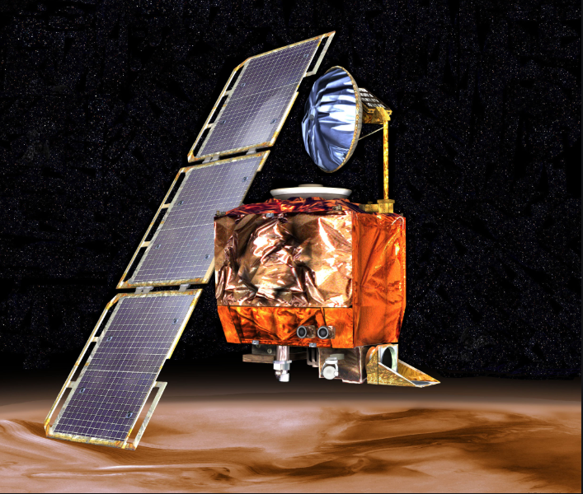
Mars Climate Orbiter
This was one of two NASA spacecrafts in the Mars Surveyor '98 program.
The mission failed because of software “interoperability” issue.
The craft drifted off course during its voyage and entered a much lower orbit than planned and was destroyed by atmospheric friction.
The metric/imperial mix-up which destroyed the craft was caused by a software error back on Earth.
Ground software used English units, flight software used metric units – caused position calculation error – both developed by different companies.
350 million dollars loss and 3.5 years loss of time.
Watch the video in supplemental Readings.
Notes:
Mars Climate Orbiter [BLF99]: This was one of two NASA spacecrafts in the Mars Surveyor '98 program. The mission failed because of software “interoperability” issue. The craft drifted off course during its voyage and entered a much lower orbit than planned, and was destroyed by atmospheric friction. The metric/imperial mix-up which destroyed the craft was caused by a software error back on Earth.. Ground software used English units, flight software used metric units – caused position calculation error – both developed by different companies. 350 million dollars loss and 3.5 years loss of time..

Slide 15
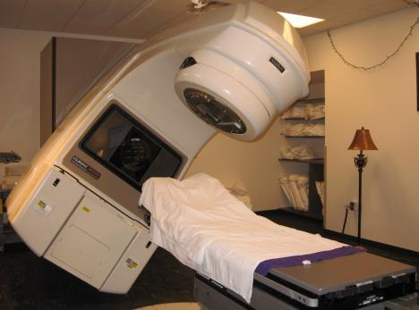
Therac 25, Medical Linear Accelerator
This was a radiation therapy machine. It was involved with at least six accidents between 1985 and 1987, in which patients were given massive overdoses of radiation, approximately 100 times the intended dose.
Software was developed by a single person, using PDP 11 assembly language, over a period of several years. The software "evolved" from the Therac-6 software, which was started in 1972.
The "program structure and certain subroutines were carried over to the Therac-25 around 1976."
It appears that unit and software testing was minimal, with most effort directed at the integrated system test.
Watch the video in supplemental Readings.
Notes:
: The Medical Linear accelerator [LT93]: This was a radiation therapy machine. It was involved with at least six accidents between 1985 and 1987, in which patients were given massive overdoses of radiation, approximately 100 times the intended dose. Three of the six patients died as a direct consequence. These accidents highlighted the dangers of software control of “safety”-critical systems, and they have become a standard case study in health informatics.
Software was developed by a single person, using PDP 11 assembly language, over a period of several years.
The software "evolved" from the Therac-6 software, which was started in 1972.
The "program structure and certain subroutines were carried over to the Therac-25 around 1976."
It appears that unit and software testing was minimal, with most effort directed at the integrated system test.

Slide 16
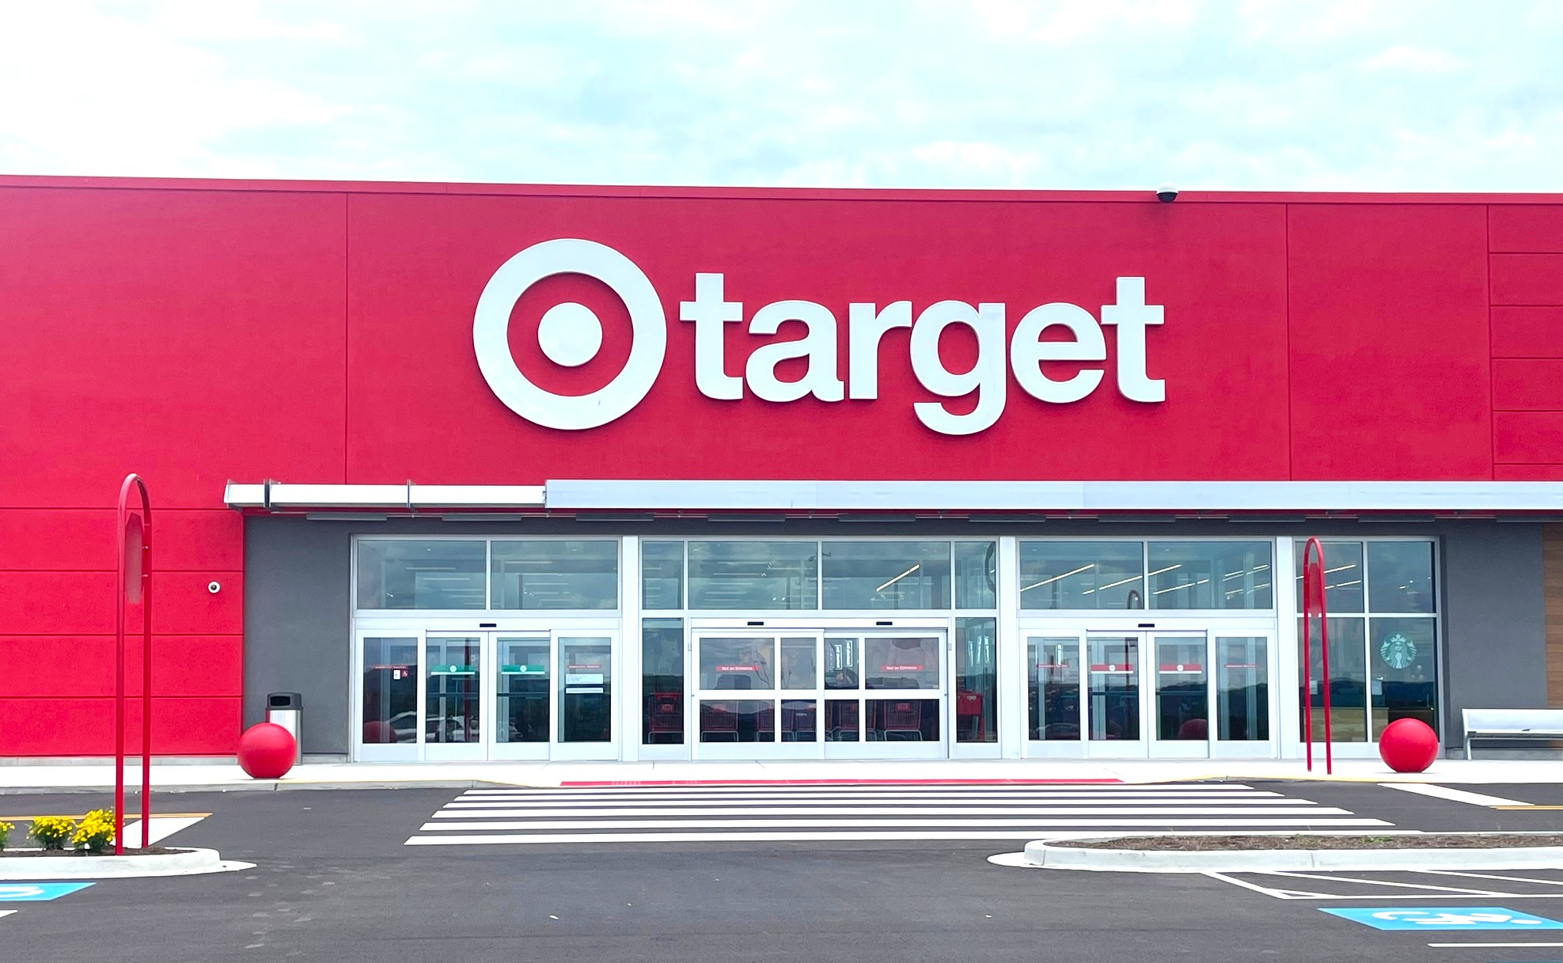
Target Credit Cards exposed
Target’s systems were compromised by a stolen password
An HVAC company had access to their networks in order to monitor the systems
This company was actually a Pittsburgh company …
The perpetrators were then able to legitimately gain access to the systems
They installed malware on the Point of Sale (POS) systems
The malware was able to steal 40 million credit cards in 2 ½ weeks
Notes:
Target’s systems were compromised by a stolen password
An HVAC company had access to their networks in order to monitor the systems
This company was actually a Pittsburgh company …
The perpetrators were then able to legitimately gain access to the systems
They installed malware on the Point of Sale (POS) systems
The malware was able to steal 40 million credit cards in 2 ½ weeks
After a forensic investigation, it was determined that the incident began when a phishing email tricked a Target employee who worked for a third-party vendor called Fazio Mechanical. Citadel, a password-stealing bot version, was installed on Fazio systems, as security blogger Brian Krebs first revealed. After Citadel was able to obtain Fazio's login credentials, the attackers were able to infiltrate Target's Ariba vendor portal, enter the company's internal network, and take over its servers.

Slide 17
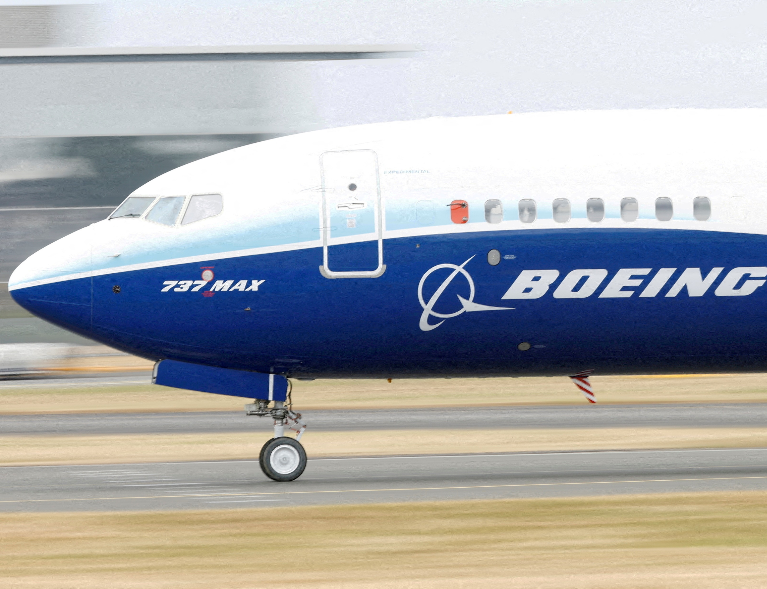
Boeing 737 Grounding
Further read:
https://en.wikipedia.org/wiki/Boeing_737_MAX_groundings
Watch the video on PBS: https://www.pbs.org/wgbh/frontline/article/boeing-737-max-jet-alaska-airlines-flight-1282-faa-safety/

Slide 18
So, what exactly is software engineering? [One Definition]
It's the systematic application of engineering principles to design, develop, test, and maintain software. It's about creating efficient, reliable, and user-friendly solutions that solve real-world problems.

Slide 19
So, what exactly is software engineering? [Another Definition]
It is a multi-layered approach, which includes processes, standards, and techniques, to allow software engineers to design, develop and maintain high-quality computer software in a timely manner.

Slide 20
So, what exactly is software engineering? [Yet Another Definition]
It is an engineering discipline that is concerned with all aspects of software production
What kind of constraints do you think you may face in the development of a software as part of a project?
Time, security, communication and financial constraints, among others.

Slide 21
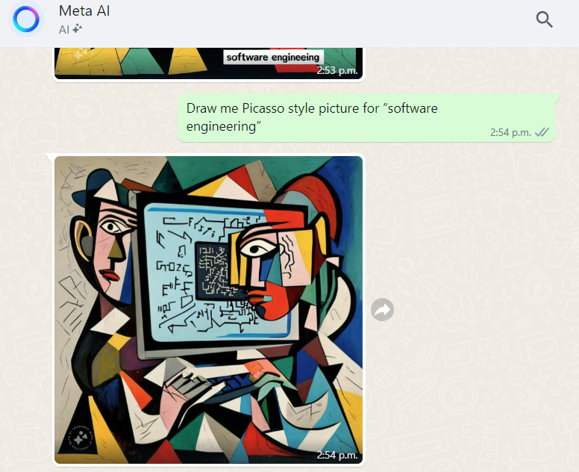
Meta ai – Imagining se: Picasso style

Slide 22
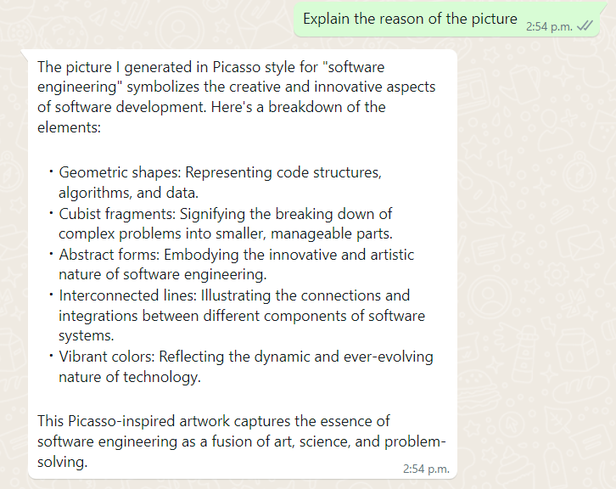
Meta ai – Imagining se: Picasso style

Slide 23
In class Exercise
Imagine you're tasked with designing an app that helps people track their daily water intake.
You want to ensure it's user-friendly, accurate, and engaging.
In groups 4-6:
Outline the key steps you would take to bring this app from concept to reality.
What challenges do you foresee in each phase, and how might you address them?
You have 10 minutes to brainstorm and create a rough plan.
Let's discuss your ideas afterward.

Slide 24
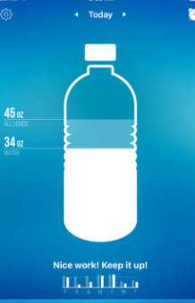
REQUIREMENTS ENGINEERING
Conduct surveys or interviews to understand user needs.
Define features like tracking, reminders, and user-friendly interface.
Consider platforms (web,iOS,Android) and compatibility.

Slide 25
Design
Create wireframes and mockups to visualize the app's layout.
Design a simple and intuitive user interface.
Plan the color scheme, fonts, and icons for a cohesive look.
Decide on the overall architecture of the system.
Design the classes to be implemented and assign responsibilities to classes and methods.
Design the Database scheme.

Slide 26
Development
Choose a programming language and framework (e.g., Swift for iOS).
Implement the user interface using code.
Develop the water intake tracking logic.

Slide 27
Testing
Perform unit tests to ensure individual components work.
Conduct usability testing with potential users.
Test the app on different devices to ensure compatibility.

Slide 28
Deployment
Prepare the app for release on app stores (Apple App Store, Google Play Store).
Ensure the app meets store guidelines and requirements.
Plan for updates and improvements based on user feedback.

Slide 29
Challenges and considerations
Ensuring accurate water intake tracking.
Addressing user privacy concerns and data security.
Balancing features with simplicity for a user-friendly experience.
Handling potential bugs or crashes in real-world usage.
Supporting different devices and screen sizes.

Slide 30
Other Issues to consider - collaboration
Effective communication between designers, developers, and testers.
Regular meetings to review progress and address challenges.
Iterative development and refining based on feedback.

Slide 31
Other Issues to consider- User Experience (UX)
Prioritizing user needs to create a seamless experience.
Designing visually appealing screens with clear interactions.
Implementing easy navigation for users of all tech levels.

Slide 32
Other Issues to consider- PROJECT MANAGEMENT
Creating a timeline for each phase of development.
Identifying potential bottlenecks and allocating resources accordingly.
Adapting the plan based on unexpected challenges and changes !

Slide 33
Other Issues to consider- SCALING AND FUTURE DEVELOPMENT
Considering future features like integration with wearable devices.
Planning for scalability as user base grows.
Keeping the app updated with new OS versions and trends.

Slide 34
SOUNDS EASY?
IMAGINE SOFTWARE PROJECTS ON LARGER SCALE:
Complex global trading system that handles billions of dollars of trades every day.
Software embedded in a jet fighter.
Software in a robotic cardiac surgery.

Slide 35
Scale of Software Systems
Software | Lines Of Code
Program for computer science assignment | 100 - 2,500
iOS simple game app | 5.000 - 10,000
Complex desktop application (e.g., Photoshop C6) | 4M - 5M
Embedded systems within automobile | 50M - 100M
All Google internet services | 2B
Notes:
Lines of code is not a great metric but it’s an easy one to measure. Testing code is a big part of the total.

Slide 36
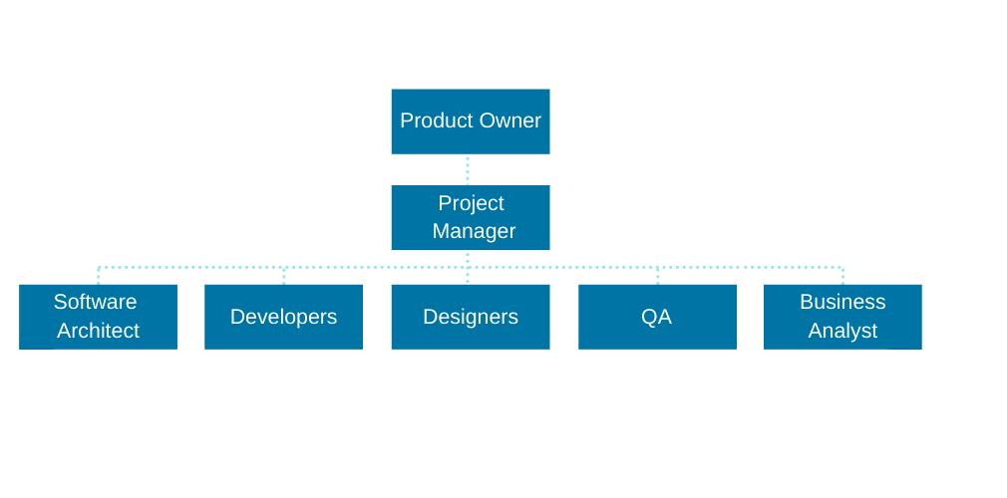
Software Engineering team
It takes a team!
SE involves wider responsibilities than simply the application of technical skills.
A popular example of a team composition
Notes:
We will learn about each of these roles and responsibilities as we progress in the course. Moreover, I made some short videos available for you to familiarize yourself with such responsibilities.
Software engineers must behave in an honest and respectful manner if they are to be respected as professionals.

Slide 37
Course description
This course is a hands-on study of the development techniques and methods of different aspects in software engineering.
Many misinterpret software engineering for being pure system coding, which is far from reality!
You will learn throughout this course that software engineering is much more than that.
Numerous procedures and steps come before, during and after implementation or coding.
Notes:
By the end of this semester, you will be able to:
Compare different software process models and choose an appropriate one to use to build a certain system
Collect and analyze the requirements and specifications for a software system.
Represent structural and behavioral aspects of a system through modelling.
Apply effective project management techniques like scheduling and risk management.
Apply effective quality assurance and maintainability principles.
Experience the application of software engineering principles and techniques in a team setting via the group project.

Slide 38

Course topics
Please refer to the course syllabus here:
https://docs.google.com/document/d/15kwjU_-Co4zCQDetKcFkcA2oYDlANi1zlt0kBeZpwN0/edit

Slide 39

Course textbooks
Textbook:
Roger S Pressman, Software Engineering: A Practitioner’s Approach, McGraw-Hill Higher Education; 9th edition
Available on github: https://intranetssn.github.io/www.ssn.net/twiki/pub/CseIntranet/CseBCS6403/PressmanBook.pdf
Other Supporting Textbooks:
B. Bruegge and A.H. Dutoit, Object-Oriented Software Engineering: Using UML, Patterns, and Java, Pearson, 3rd edition
I. Sommerville, Software Engineering, Pearson, 10th edition

Slide 40
Assessment tasks
Activity Detail | Grade Percentage | Submission Date/Week
Class Participation | 5% | Ongoing
Assignments | 20% | Ongoing
Group Project | 25% | Ongoing
Midterm Exam | 25% | Week 8
Final Exam | 25% | Exam week
Please refer to the course syllabus/logistics on piazza for assignment extension, submission, grading and integrity policies
Notes:
Attendance for this course is mandatory. Every absence needs to be agreed upon with me prior to class.
Class Participation: Students are encouraged and expected to be active participants in class discussions and activities.
Class exercises: Many class discussions will be interactive via hands-on sessions where the students work in groups to solve a given problem/exercise.
It is crucial to interact with each other respectfully - in and outside the classroom.
Assignments: assess your grasp of different concepts and methods
The exams dates are there so keep them in mind

Slide 41
Assignments and group project
There will be 3 individual assignments and 1 group project with multiple deliverables.
Late submissions will be accepted only up to 2 days late (with a penalty), afterwards zero points will be received automatically. All assignments/deliverables are due at 11:59pm on the due date. Submission will be done through Gradescope.
Beyond that 10% will be deducted from the task grade. Students MUST follow the code of conduct and adhere to the standards of academic integrity at BU. Violations will be reported to the Vice Provost for Academic Affairs

Slide 42
Academic Integrity
Students MUST follow the code of conduct with the assignments and the project and adhere to the standards of academic integrity at BU.
Integrity violations, e.g., plagiarism cases, will be reported to the Vice Provost for Academic Affairs.
In addition, it forbids capturing, reposting, sharing, or distributing in any form conversations, course materials (including presentation slides, quizzes, assignments and exams), or solutions to any of the assessment tasks.
Notes:
10% deduction or the assignment grade, whichever is higher, for first timers.
Formal hearing resulting in failing the course, for second timers.
Suspended for a semester, for third or more timers in addition to failing the course.

Slide 43
Academic integrity Violations
Copying or paraphrasing someone's work is considered an integrity violation
Permitting your own work to be copied or paraphrased, even if only in part, is considered an integrity violation
Posting or sharing your solutions in any form whilst you are a student at BU (even after you are done with the course) is considered an integrity violation
Any submission of yours should reflect your own work. If you believe you are going to have trouble completing an assignment or with the project, please reach out to the course professor or TA at once.
You should start working on any assignment as soon as it’s released and adhere to the Assignment Submission and Extension Policies in this course

Slide 44
Attendance policy
Students are expected to attend all classes and be active participants in class discussions, exercises, and activities. It is essential to engage colleagues with respect in and outside the classroom. Participation will be graded based on attendance and participation.
To get the full 5% participation, students must have attended at least 90% of all lectures.

Slide 45
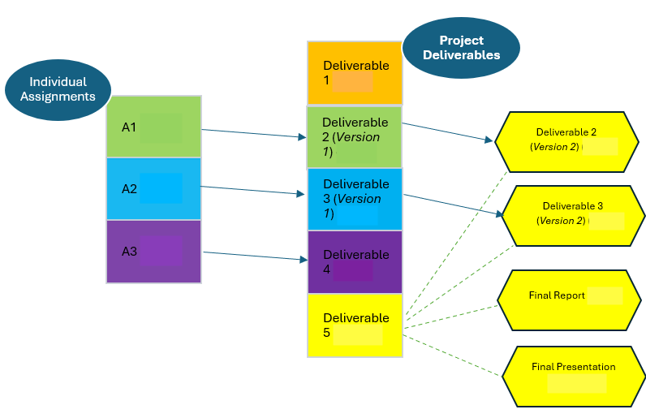
INTRODUCING COURSE PROJECT (all info in project folder)

Slide 46


Readings , Assignments, Project Tasks
Read:
Chapter 1 of the textbook.
Assignments & Project Tasks:
The project is open. Start forming the teams and work on Project Deliverable 1.

